Slide 1
Mobile Development :
1 : Introduction
Professor Imed Bouchrika National School of Artificial Intelligence imed.bouchrika@ensia.edu.dz

Slide 2
Outline :
Mobile Market : Statistics
Business Aspects for Mobile Dev
History of Mobile App Dev
Types of Mobile Applications
Prep for Lab Session :
Introduction to Kotlin

Slide 3
Mobile Market : Statistics
As a mobile user : are we addicted to our phones ?
We are becoming deeply addicted to our phones
Globally, the average mobile user spent 4.8 hours on their mobile device
85% of time spent on smartphones is spent on using apps. (As opposed to phone calls.)
The average smartphone owner uses 9-10 apps per day and 30 apps per month.
The number of downloads for mobile apps in 2022, exceeds 255 billion
Notes:
Why we start with stats : to gain insight on the market + motivate ourselves to the mobile dev arena

Slide 4
Mobile Market : Statistics
Addicted for various reasons :
Social connection
Work and Productivity
Information and News
Entertainment
Fear of Missing Out (FOMO)
Escapism
Boredom
…
As a mobile user : are we addicted to our phones ?
We are becoming deeply addicted to our phones
Globally, the average mobile user spent 4.8 hours on their mobile device
85% of time spent on smartphones is spent on using apps. (As opposed to phone calls.)
The average smartphone owner uses 9-10 apps per day and 30 apps per month.

Slide 5
Mobile Market : Statistics
As a mobile user : How many users ?
The number of smartphone mobile network subscriptions worldwide reached almost 6.4 billion in 2022, and is forecast to exceed 7.7 billion by 2028.
85.88% of people have smartphones today
China, India, and the United States are the countries with the most number of mobile users.

Slide 6
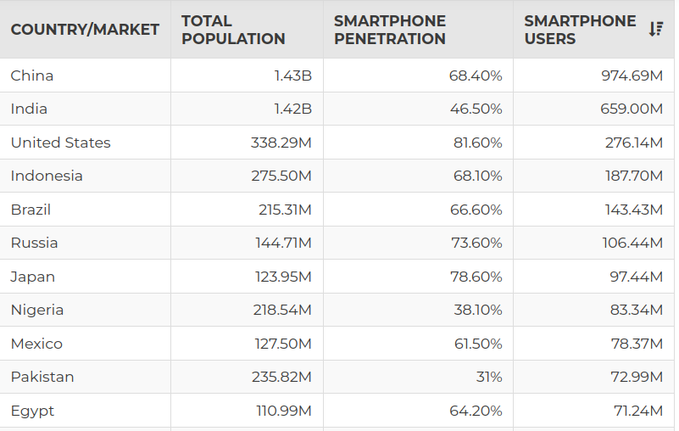
Mobile Market : Statistics
As a mobile user :

Slide 7
Mobile Market : Statistics
As a mobile user : What we do most ? :
50% of app users mainly use apps for communication ( including social networking and chat)
There are over 700,000 educational apps on the market.
Total hours spent watching video streaming apps grew 32% worldwide.
62% of people have a gaming app installed on their phone.

Slide 8
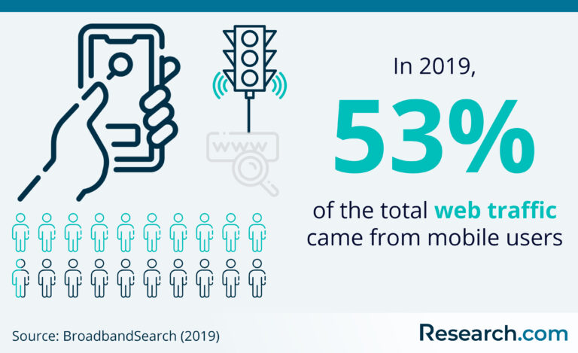
Mobile Market : Statistics
As a mobile user : Compared to a desktop user:
Significantly more searches are carried out on the mobile phone (64%) than on the desktop (35%).
53% of web traffic comes from mobile phones.

Slide 9
Mobile Market : Statistics
As a company :
Having a mobile app for a company regardless of their activities, is imperative for their survival :
33% of American retailers have at least one app,
42% of small businesses now have a mobile app
Fortune 500 companies have their mobile apps.
Overseas Brands Grow International Footprint, Growing Market Share by 11% in Some Regions

Slide 10
Mobile Market : Statistics
As a Mobile App Developer:
The number of Mobile Apps is estimated as (As of 24 Sep 2023) :
1.8 million Apps inside the Apple App Store
3.77 million apps on the Google Play Store.
Microsoft App Store estimated as 800K, whilst Amazon App Store has around 500k.
Only 0.5% of apps are successful. 9,999 out of 10,000 apps will fail.
App crashes cause 71 percent of uninstalls
70 percent of users abandon an app because it takes too long to load ( too long = more than 3 seconds)

Slide 11
Mobile Market : Statistics
As a Mobile App Developer:
The market share of mobile OSs, As of January 2023,
Android holds a 71.63% market share in the operating system (OS) market.
iOS has a 27.68% market share in the OS market.
Samsung’s market share in the OS market is 0.35%.
KaiOS holds a 0.11% market share in the OS market.
Windows has a 0.02% market share in the OS market.
HarmonyOS is estimated to have 2% in the second quarter of 2023

Slide 12
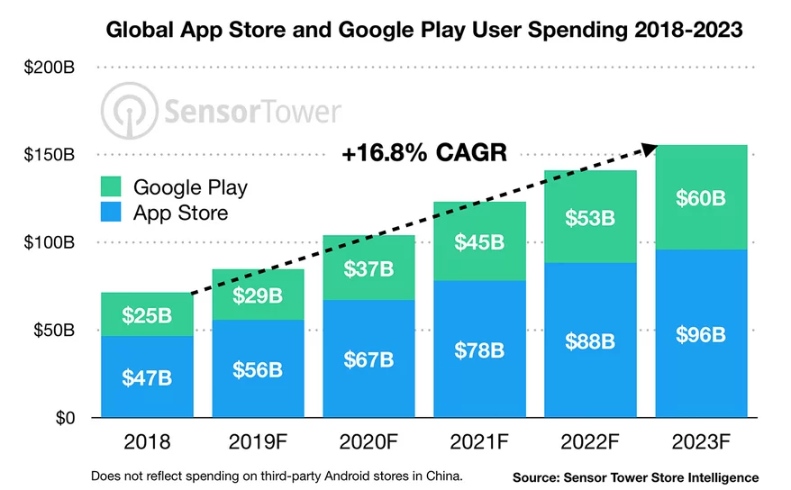
Business Aspects of Mobile Dev
How much money in terms of revenue :
App Store Spend :

Slide 13
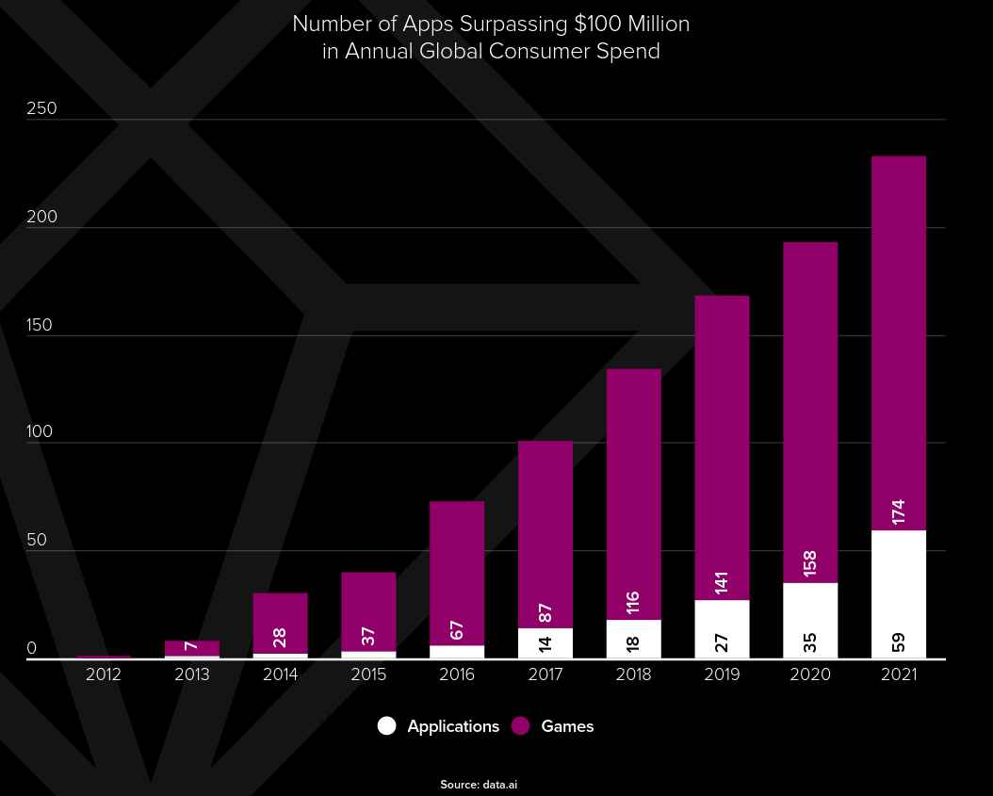
Business Aspects of Mobile Dev
How much money in terms of revenue :
In 2021, there were over 230 apps and games surpassing $100M in annual consumer spend, with 13 of them surpassing $1 Billion.
Data & Image taken from Data.ai

Slide 14
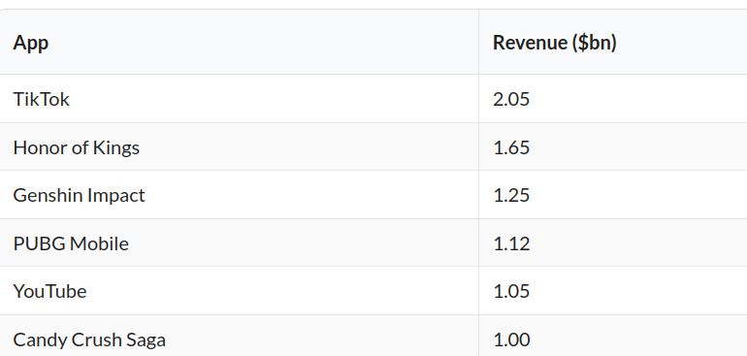
Business Aspects of Mobile Dev
Startups, Companies and Ventures

Slide 15
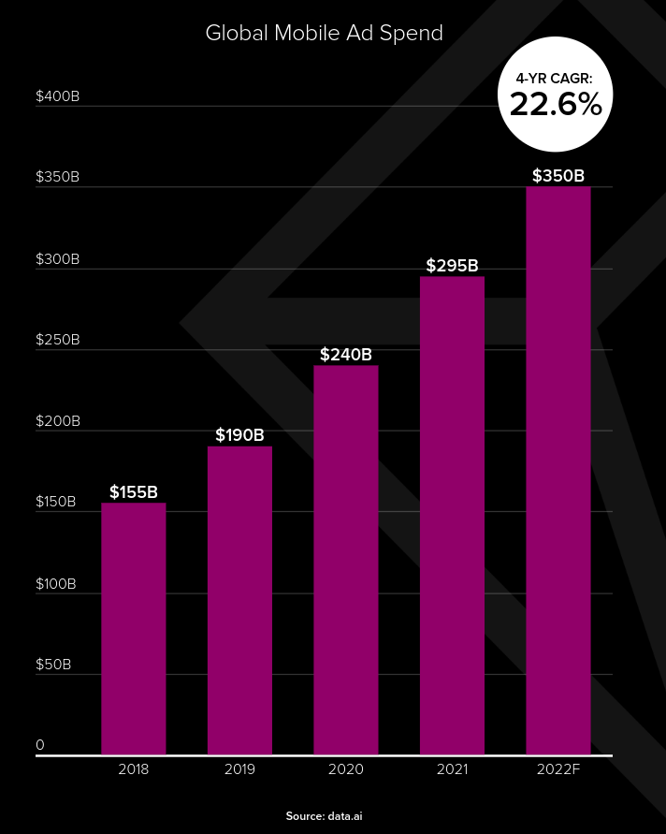
Business Aspects of Mobile Dev
How much money companies spend in advertising within Apps ?
Companies spend over $350B for advertising in mobile platforms
Data & Image taken from Data.ai

Slide 16
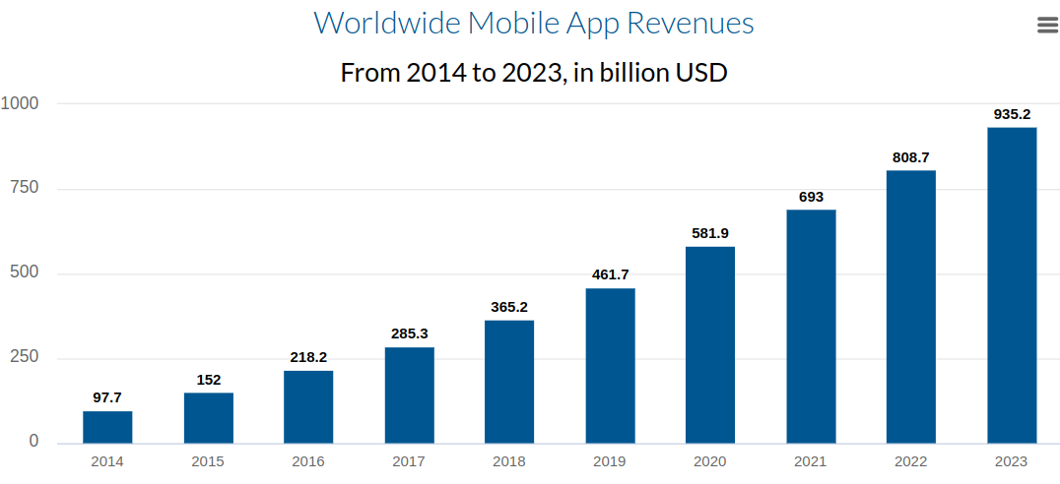
Business Aspects of Mobile Dev
Other ways of making money ?
In-App Purchases
Subscriptions
Data & Image taken from iResearch + financesonline

Slide 17
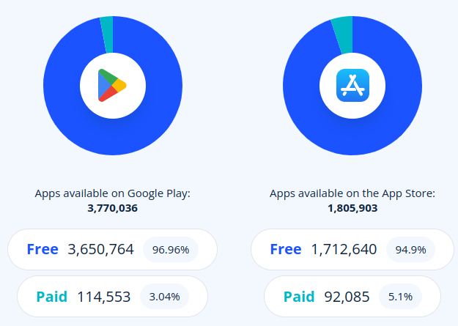
Business Aspects of Mobile Dev
Free vs. Paid App ?
Most of the app revenue is coming the free apps.
Only a fraction of people are willing to pay for an App.
Data & Image taken from 42matters

Slide 18
Business Aspects of Mobile Dev
Revenue for Development ?
Is it cheap to produce a mobile App ?
How much money to pay a developer to build an App ?
How much mobile app developer gets paid ?
How Long does it take to fully develop a mobile app ?
Which is better ? Mobile vs. Web Development

Slide 19

Business Aspects of Mobile Dev
“Mobile is the future of Software Development,”
says Eric Schmidt ( Ex-CEO of Google).

Slide 20
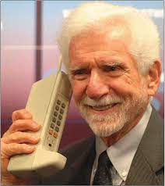
History of Mobile App Development
1973-1995 : Basic Phone
1973 : Martin Cooper invented the first mobile phone
1983 : DumaTAC 8000x is the first commercialized phone.
1993 : IBM announced the first touch phone called IBM Simon with apps : Clock, Calendar, notepad and Calculator, released in 1994
Data taken from

Slide 21
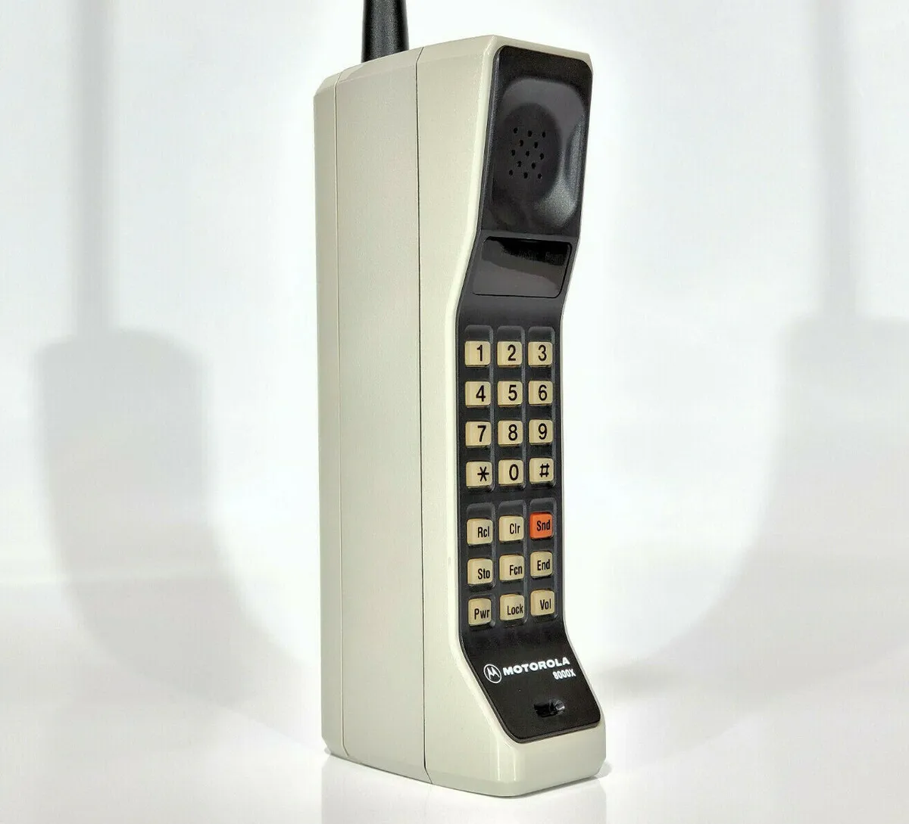
History of Mobile App Development
1973-1995 : Basic Phone
1973 : Martin Cooper invented the first mobile phone at Motorola
1983 : DumaTAC 8000x is the first commercialized phone by Motorola.
1993 : IBM announced the first touch phone called IBM Simon with apps : Clock, Calendar, notepad and Calculator, released in 1994

Slide 22
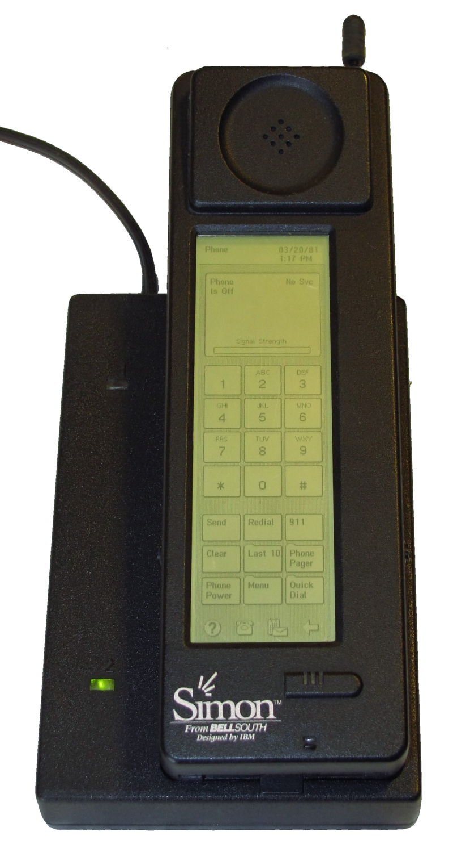
History of Mobile App Development
1973-1995 : Basic Phone
1973 : Martin Cooper invented the first mobile phone
1983 : DumaTAC 8000x is the first commercialized phone.
1993 : IBM announced the first touch phone called IBM Simon with apps : Clock, Calendar, notepad and Calculator, released in 1994

Slide 23
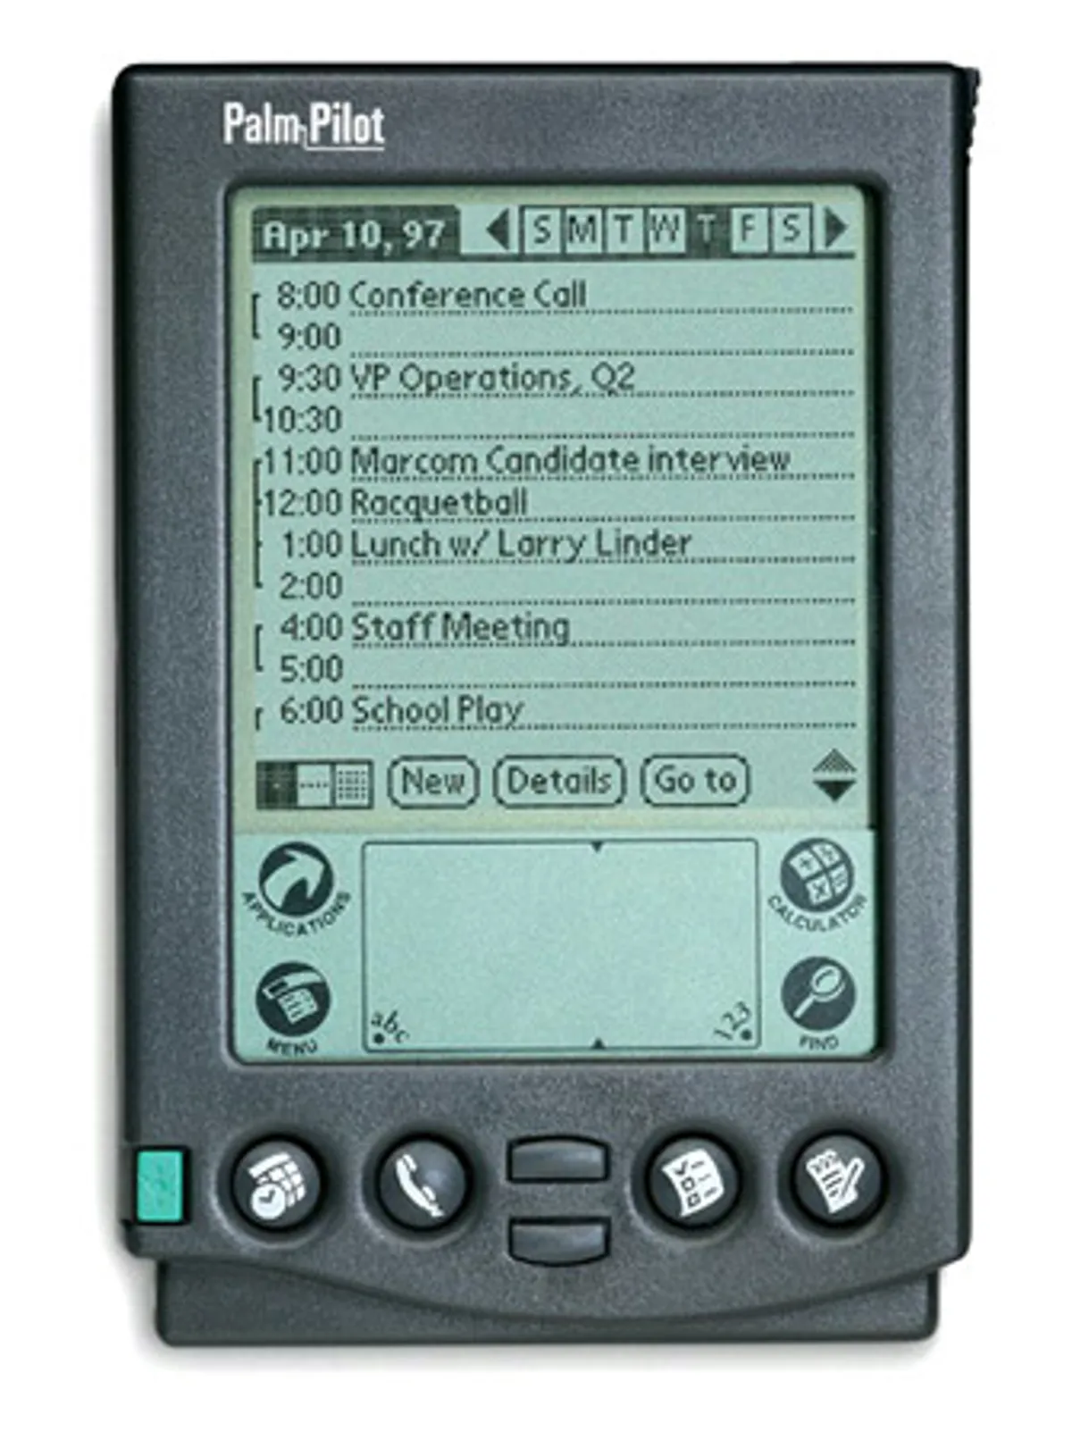
History of Mobile App Development
1996-2006 : Feature Phone
1997 : The PalmPilot was debuted running PalmOS with the ability to run 3rd Party apps.
1999 : Blackberry OS was introduced and made its debut for the Pager Blackberry 850.
2000 : Microsoft introduced the tablet PC.
2002 : The BlackBerry 5810 smartphone was introduced
2003 : Andy Rubin, Rich Miner, Nick Sears, and Chris White launched Android Inc.
2005 : Google paid at least $50 million for Android Inc.

Slide 24
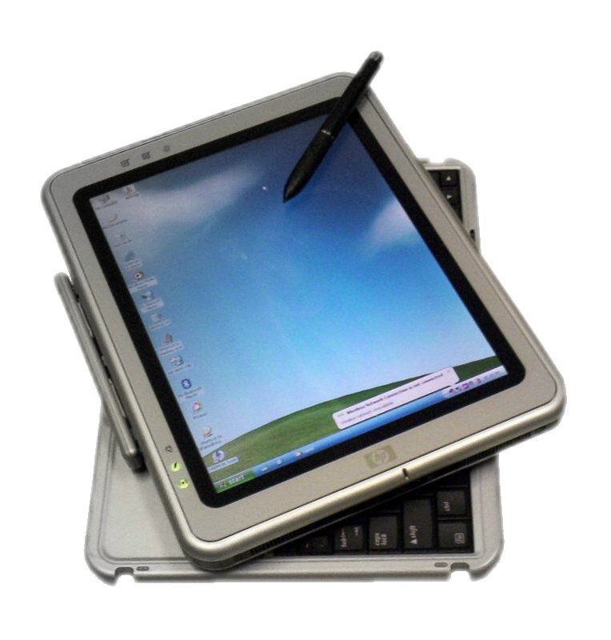
History of Mobile App Development
1996-2006 : Feature Phone
1997 : The PalmPilot was debuted running PalmOS with the ability to run 3rd Party apps.
1999 : Blackberry OS was introduced and made its debut for the Pager Blackberry 850.
2000 : Microsoft introduced the tablet PC.
2002 : The BlackBerry 5810 smartphone was introduced
2003 : Andy Rubin, Rich Miner, Nick Sears, and Chris White launched Android Inc.
2005 : Google paid at least $50 million for Android Inc.

Slide 25
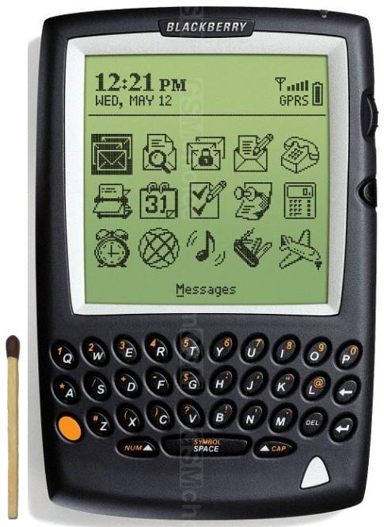
History of Mobile App Development
1996-2006 : Feature Phone
1997 : The PalmPilot was debuted running PalmOS with the ability to run 3rd Party apps.
1999 : Blackberry OS was introduced and made its debut for the Pager Blackberry 850.
2000 : Microsoft introduced the tablet PC.
2002 : The BlackBerry 5810 smartphone was introduced
2003 : Andy Rubin, Rich Miner, Nick Sears, and Chris White launched Android Inc.
2005 : Google paid at least $50 million for Android Inc.

Slide 26
History of Mobile App Development
2007-Now : Smartphone
2007 : Steve Jobs unveiled the iPhone, which had been a long time coming.
2008 : Launch of Apple's app store with 552 apps available.
2008 : Android is released with its Android Market

Slide 27
Types of Mobile Applications
What’s a Mobile App ?
A software product designed to install and execute on a mobile device ( not necessarily phone) in order to perform certain tasks for the user.

Slide 28
Types of Mobile Applications
Apps are meant only for smartphones ?
Mobile Apps are now being developed for various devices including :
Tablets
Smart watches
TVs
Cars
…

Slide 29
Types of Mobile Applications
Different Types of Apps :
Native
Web
Hybrid

Slide 30
Types of Mobile Applications
Native Mobile App:
Applications which are coded to install and run directly on the operating system without any intermediary layer/app.
They are usually coded using a specific programming language and target for a specific platform/device.

Slide 31
Types of Mobile Applications
Native Mobile App:
Pros :
Fast and better performance.
Easy to benefit from the device/hardware functionalities ( Camera, accelerometer, GPS, biometric sensor, Touch/Gesture interactions, Microphone....)
Cons:
More expensive to develop + Hard to maintain + Extremely difficult to target multiple platforms as you need to maintain different code base.

Slide 32
Types of Mobile Applications
Web App
is simply a website that can be accessed from a browser. Web Apps are usually built as responsive as possible to accommodate different screen sizes.
For Websites, shall we create the desktop/main website mobile friendly/responsive or shall we create a newly dedicated website for mobile users ?
They need an internet connection to access the website

Slide 33
Types of Mobile Applications
Web App:
Pros :
Easy, cheap to develop
Run on various platforms with a browser
Maintenance is easy as it is centralised
Cons:
No access to the device functionality ( or limited now with the advance of web technologies)
Cannot work for offline (Though, even it can be done using JS, it is hard to maintain)

Slide 34
Types of Mobile Applications
Hybrid or Progressive Web App (PWA) :
is an installable application which makes use of Web Technologies and Frameworks with more rich functionalities, Still, it may requires a backend when needed.
It combines the native + web features,
Hardware/device functionalities can be accessed.
Even though PWA does not need a browser to run, they use a built-in browser component.
They can work offline without any internet connection.

Slide 35
Types of Mobile Applications
Hybrid or Progressive Web App (PWA) :
Pros :
Easy to develop and maintain + Cheap
Faster build time
One code base can be used for various platforms.
Cons :
Performance is questionable.
May turn complex depending on the features

Slide 36
Types of Mobile Applications
Hybrid or Progressive Web App (PWA) :
Example :
Gmail
Twitter
Instagram

Slide 37
Types of Mobile Applications
Characteristics | Web app | Hybrid app | Native app
Usage | Users can access directly from a browser | Users have to install the app on their device of choice | Users have to install the app on their device of choice
Internal working | Client code in the browser communicates with remote server-side code and databases | Client code and browser code wrapped in a native shell or container | Client code written in technology and language specific to the device or platform it will be installed on
Native device features | Not accessible | Accessible | Accessible
User experience | Inconsistent and dependent on the browser being used | Consistent and engaging | Consistent and engaging
Access | Limited by browser and network connectivity | One-step access with offline features | One-step access with offline features
Performance | Slower and less responsive | Faster, but may consume more battery power | Performance can be optimized to device
Development | Cost-efficient, faster time to market | Cost-efficient, faster time to market | Expensive, slower time to market
Copied from https://aws.amazon.com/compare/the-difference-between-web-apps-native-apps-and-hybrid-apps/

Slide 38
Lab Session : Introduction to Kotlin
Kotlin is a concise, safe, cross-platform, statically typed programming language initiated and developed by the company JetBrains.
Kotlin works on different platforms (Windows, Mac, Linux, Raspberry Pi, etc.)
Kotlin is used to develop Android apps in addition to server side apps.
the first “stable” release (Kotlin 1.0) was only released by JetBrains in February 2016.
Kotlin is designed to interoperate fully with Java. Embedding Java frameworks and libraries in Kotlin is as easy as copying them from Java and vice versa.

Slide 39
Lab Session : Introduction to Kotlin
The popularity of Kotlin was boosted by Google when it became an officially-supported programming language for Android development in 2017.
Kotlin experienced a further surge in adoption when Google officially made the language its recommended choice for Android app development in 2019 as opposed to Java.

Slide 40
Lab Session : Introduction to Kotlin
Despite Kotlin’s short existence, more than 20% of the apps active in the Play Store today have been coded with it.
Among the most popular 500 US apps, an impressive 87% were developed with Kotlin
Kotlin is today’s #1 choice for Android app development for many developers as well as Google.

Slide 41
Lab Session : Introduction to Kotlin
Popular Apps made using Kotlin
Slack
Dropbox
Twitter
Acrobat Reader
AmericanExpress
Pinterest
Evernote
…

Slide 42
Lab Session : Introduction to Kotlin
fun main() {
println("Hello World")
}
Hello World in Kotlin vs Java:
Kotlin
Java
public Class HelloWorld{
public static void main(String[] args) {
System.out.println(“Hello, World!”);
} }

Slide 43
Lab Session : Introduction to Kotlin
fun main() {
println("Hello World")
}
Hello World in Kotlin vs Java:
Kotlin
Java
No semicolon in Kotlin
fun is an acro for a function
public Class HelloWorld{
public static void main(String[] args) {
System.out.println(“Hello, World!”);
} }

Slide 44
Lab Session : Introduction to Kotlin
Compiling and Running Hello World in Kotlin:
To install Kotlin on Linux : sudo apt install kotlin
Save your hello code in a file named as hello.kt
To compile : kotlinc Hello.kt -include-runtime -d Hello.jar
To execute using Java Virtual Machine java -jar Hello.jar

Slide 45
Lab Session : Introduction to Kotlin
Variables
To create a variable, we use:
var : dynamic variable
val : constant variable that cannot be changed
fun main() { var name = "John" val birthyear = 1975
println(name)
println(birthyear)
}

Slide 46
Lab Session : Introduction to Kotlin
Variables
To create a variable, we use:
var : dynamic variable
val : constant variable that cannot be changed
fun main() { var name = "John" val birthyear = 1975
println(name)
println(birthyear)
}
When creating a variable without explicitly setting the type, you must initialize the variable.

Slide 47
Lab Session : Introduction to Kotlin
Variables
To create a variable, we use:
var : dynamic variable
val : constant variable that cannot be changed
fun main() { var name val birthyear = 1975 name = "John"
println(name)
println(birthyear)
}
Will raise an error

Slide 48
Lab Session : Introduction to Kotlin
Variables
To assign manually a variable to a type :
var varName : Type = ABC
fun main() { var name : String = "John" val birthyear : Int = 1975
println(name)
println(birthyear)
}

Slide 49
Lab Session : Introduction to Kotlin
Variables
Recommend Best Practices and Rules:
Use camelCase naming : firstName instead of firstname
Be consistent and use only letters ( avoid the dollar sign or even the underscore..)
Names should start with a lower case letter
Avoid the use of special keywords ( var, int, for …)

Slide 50
Lab Session : Introduction to Kotlin
Variables
To convert a numeric data type to another type, you must use one of the following functions: toByte(), toShort(), toInt(), toLong(), toFloat(), toDouble() or toChar()
fun main() { val x: Int = 5
val y: Long = x.toLong()
println(y)
}

Slide 51
Lab Session : Introduction to Kotlin
Data Types and Arrays :
val cars = arrayOf("Volvo", "BMW", "Ford", "Mazda") println(cars.size) println(cars[0]) if ("Volvo" in cars) { println("It exists!") } for (x in cars) { //some business logic }

Slide 52
Lab Session : Introduction to Kotlin
Data Types and Arrays :
You can specify the data type of elements for an Array
val cars : Array<String>= arrayOf("Volvo", "BMW", "Ford", "Mazda")
val cars = arrayOf<String>("Volvo", "BMW", "Ford", "Mazda")

Slide 53
Lab Session : Introduction to Kotlin
Data Types and Arrays :
Can we use an array to store elements of different types ( Integers and Strings) ?
val data = arrayOf("Volvo", "BMW", "Ford", "Mazda", 2 , ‘A’, true)

Slide 54
Lab Session : Introduction to Kotlin
Data Types and Arrays :
Can we use an array to store elements of different types ( Integers and Strings) ?
Most programming languages don’t allow . Kotlin is an exception
val data = arrayOf("Volvo", "BMW", "Ford", "Mazda", 2 , ‘A’, true)

Slide 55
Lab Session : Introduction to Kotlin
Data Types and Arrays :
Arrays have a fixed size. For dynamic size, you need to use ArrayList.
To initialize an array with N elements :
fun main() { var myArray = arrayOfNulls<Any>(10) for (i in 0..myArray.size){
myArray[i]=i*2 println(myArray[i]) } }

Slide 56
Lab Session : Introduction to Kotlin
fun sayHello() { println("Hello World ! ") }
fun printAge(fname: String,age: Int) { println(fname + " has the age of "+ age) }
fun main() { sayHello() printAge(“Adam”, 10) }
Functions
A function can take Parameters but you need to specify the type.

Slide 57
Lab Session : Introduction to Kotlin
fun sumNumber(x: Int, y : Int = 10, z: Int =0):Int{ var r=x+y+z return r }
fun main() { var result=sumNumber(6,7) println(“Sum is “+result) result=sumNumber(6) println(“Sum is “+result) result=sumNumber(6,z=20) println(“Sum is “+result) }
Functions
A function can take Parameters but you need To specify the type.
The argument Y has a default value of 10.

Slide 58
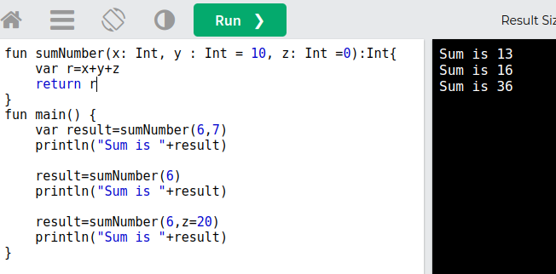
Lab Session : Introduction to Kotlin
fun sumNumber(x: Int, y : Int = 10, z: Int =0):Int{ var r=x+y+z return r }
fun main() { var result=sumNumber(6,7) println(“Sum is “+result) result=sumNumber(6) println(“Sum is “+result) result=sumNumber(6,z=20) println(“Sum is “+result) }
Functions
A function can take Parameters but you need To specify the type.
The argument Y has a default value of 10.

Slide 59
Lab Session : Introduction to Kotlin
Functions
Concise and shorter syntax
fun sumNumber(x: Int, y : Int = 10, z: Int =0 ) = x+y+z
fun main() { var result=sumNumber(6,7) println(“Sum is “+result) result=sumNumber(6) println(“Sum is “+result) result=sumNumber(6,z=20) println(“Sum is “+result) }

Slide 60
Lab Session : Introduction to Kotlin
fun main() {
val time = 20 if (time != 18) { println("Good day.") } else { println("Good evening.") }
val greeting = if (time < 18) "Good day." else "Good evening."
}
Flow Control : IF ELSE
For the case when if is used for assignment Expression, ELSE is required.

Slide 61
Lab Session : Introduction to Kotlin
Flow Control : Logical Operators
== Comparison
!= not equal
&& Logical and
|| Logical OR
! not

Slide 62
Lab Session : Introduction to Kotlin
fun main() { val cars = arrayOf("Volvo", "BMW", "Ford", "Mazda") for (x in cars) { println(x) } for (x in 1..10) println(x) for (x in 1..<10) println(x)
for (x in 1..10 step 2) println(x)
for (x in 10 downTo 10) println(x)
}
For Loops
break & continue : They can be used as Python/Java

Slide 63
Lab Session : Introduction to Kotlin
fun main() { val day = 4 val result = when (day) { 1 -> "Monday" 2 -> "Tuesday" 3 -> "Wednesday" 4 -> "Thursday" 5 -> "Friday" 6 -> "Saturday" 7 -> "Sunday" else -> "Invalid day." } println(result)
}
Flow Control : when
It is the same as switch in Java

Slide 64
Lab Session : Introduction to Kotlin
Kotlin Console I/O
It is the same as switch in Java
import java.util.Scanner
fun main() {
val scanner = Scanner(System.`in`)
println(scanner.nextLine()) // read the whole line
println(scanner.nextInt()) // get the next integer
println(scanner.next()) // get the next string
println(scanner.nextDouble()) // get the next double
println(scanner.nextLong()) // get the next long
scanner.close()
}

Slide 65
Lab Session : Introduction to Kotlin
Kotlin Console I/O
It is the same as switch in Java
import java.util.Scanner
fun main() {
val scanner = Scanner(System.`in`)
println(scanner.nextLine()) // read the whole line
println(scanner.nextInt()) // get the next integer
println(scanner.next()) // get the next string
println(scanner.nextDouble()) // get the next double
println(scanner.nextLong()) // get the next long
scanner.close()
}
Some of the Kotlin keywords are valid identifiers in Java: in, object, is, and other. If a Java library uses a Kotlin keyword for a method, you can still call the method escaping it with the backtick (`) character:

Slide 66
Lab Session : Introduction to Kotlin
Comments :
//
/* any text here Kk */

Slide 67
Lab Session : Introduction to Kotlin
Try Kotlin online :
https://play.kotlinlang.org/

Slide 68
Lab Session : Introduction to Kotlin
Next Lectures and Lab Sessions
OOP
More on Kotlin

Slide 69
References
https://www.data.ai/en/go/state-of-mobile-2022/
https://42matters.com/stats
https://ideausher.com/blog/mobile-app-industry-trends-and-statistics/
https://www.w3schools.com/KOTLIN/index.php
https://kotlinlang.org/docs/home.html
https://aws.amazon.com/compare/the-difference-between-web-apps-native-apps-and-hybrid-apps/

